Slide 2


Analysis of FPAs in the LHC RB circuit
Christoph Obermair, TE-MPE-CB Lukas Felsberger, TE-MPE-MI Franz Pernkopf, TU-Graz Andrea Apollonio, TE-MPE-CB Daniel Wollmann, TE-MPE-CB

Slide 3
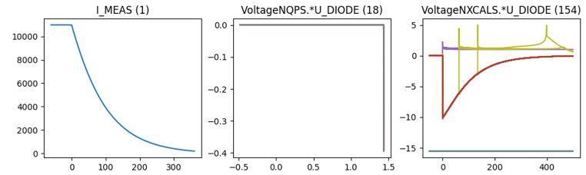
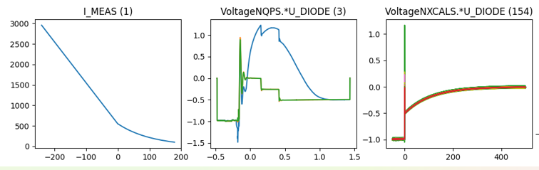
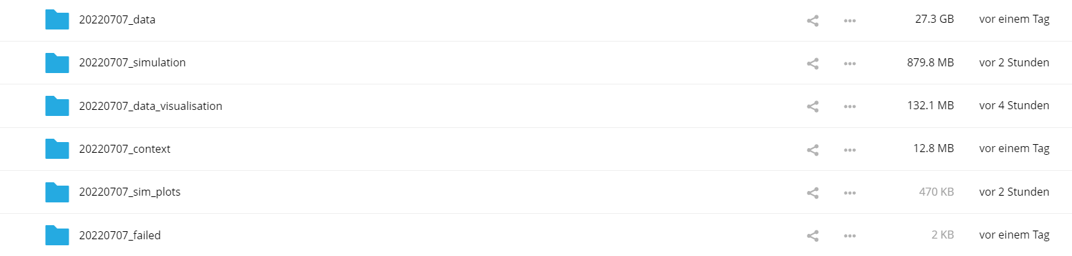
Existing Database Overview
Data overview
Filtered events
 | Signal | 2014-2020 | 2021 | # events
Real Data | U_DIODE_NXCALS | P | P | 867
 | U_DIODE_PM | P | P | 629
 | I_MEAS | P | P | 896
 | U_QSO, U_1, U_2 | P | P | 893
 | I_EARTH_PCNT | P | P | 895
 | I_EARTH | P | P | 629
 | I_HDS, U_HDS | P | P | 896
 | EEUDumpResPM | P | P | 896
Simulations | V(0v_magf*) | P | P | 875
 | I(r1_warm) | P | P | 875
 | V(10,11), V(18,19) | P | P | 875
#events |  | 267 | 629 | 560/896
Database stored at EOS ml-for-alarm-system/private/RB_signals

Slide 4
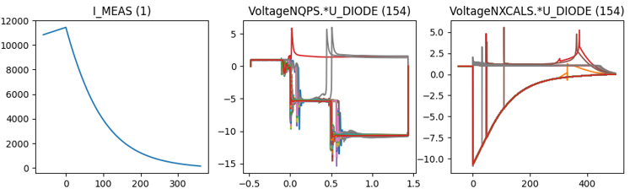
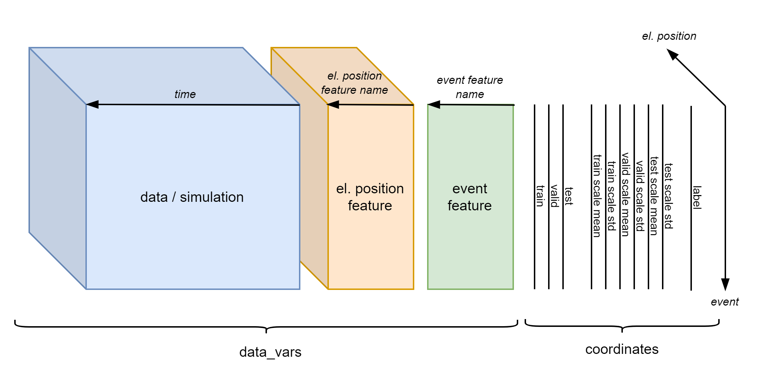
Creating Datasets
For further processing, data must be:
Contain the same phenomenon: Drop signals of quenched magnets
Filtered: Drop signals with wrong data
Aligned: Energy extraction must start at the correct time
Merged: Fit simulations to real data
Cropped: All events must have same length/index

Slide 5
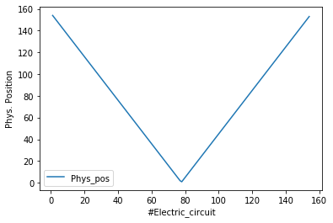
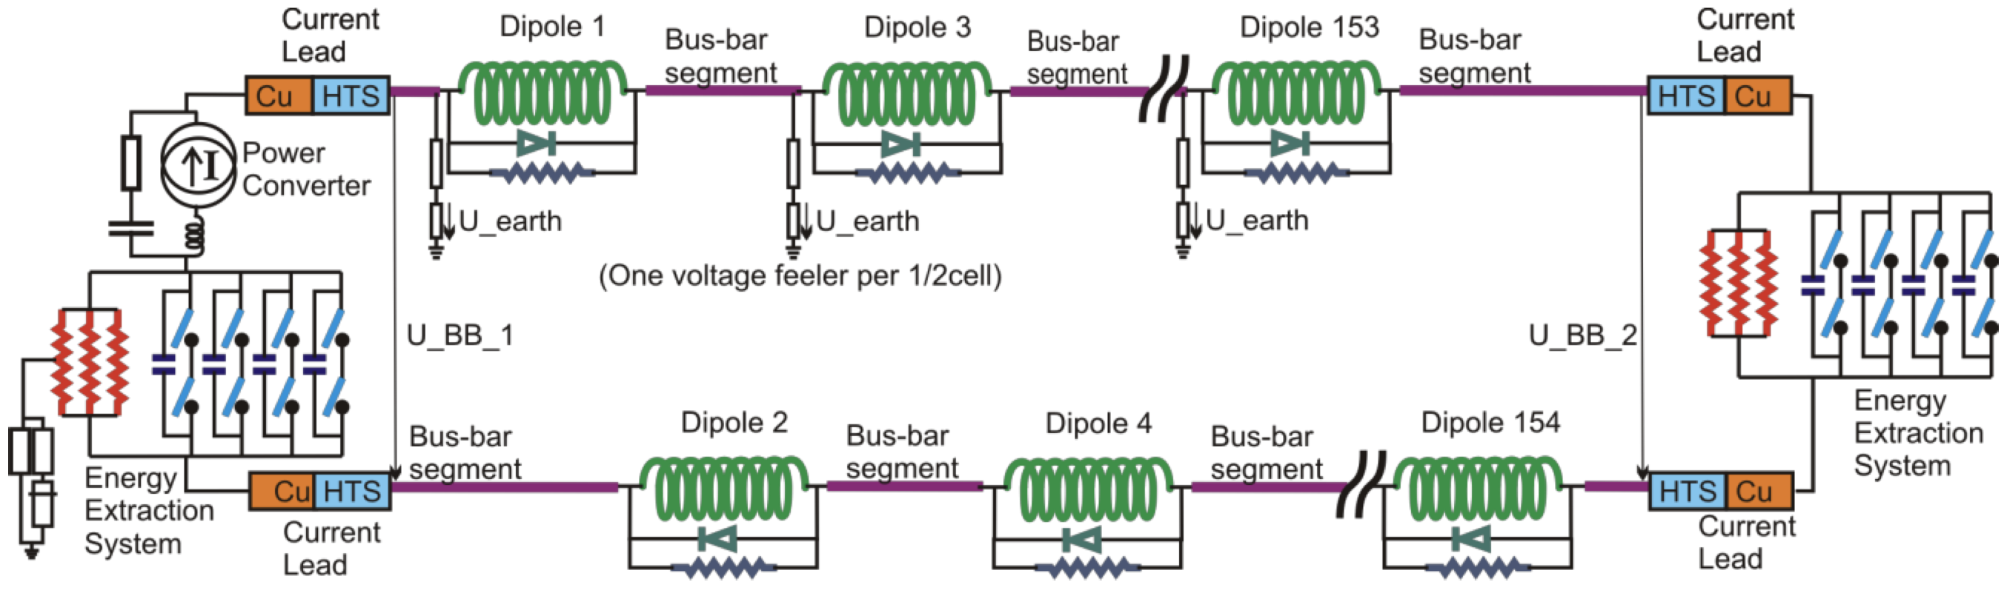
El. Vs Phys. Position
RB.A12
Phys. Position / El. Position
A8R1
1 / 78
A9R1
3 / 79
B8L2
153 / 154
B8R1
2 / 77
B9R1
4 / 76
A8L2
154 / 1

Slide 6
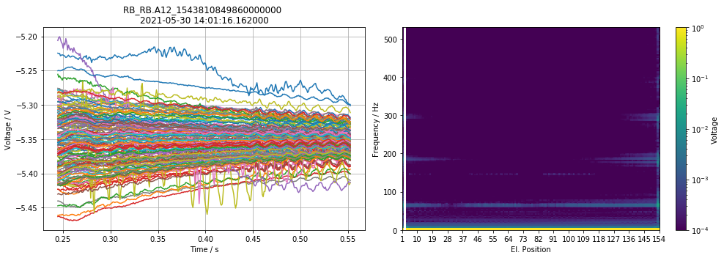
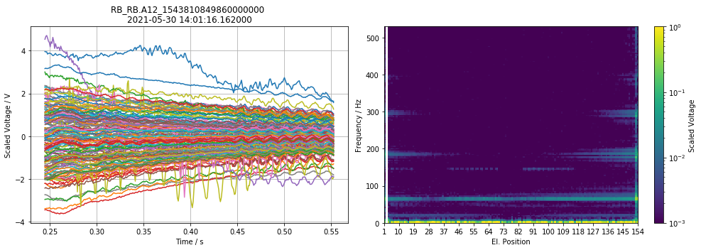
Signal vs. scaled signal
Signal
Scaled Signal

Slide 7

Overview of Data-Driven Models
High incorporation of knowledge and context
Data-Driven Models
Manual Feature Engineering
Manual Threshold
Probabilistic
Classic Machine Learning
Automatic Feature Eningeering
Discriminative Deep Learning
Generative Deep Learning
GAN, RNN, ProtoNET
MLP, DCNN, FCN
SVM, Random Forrest, MLP
e.g. Busbar Resistance
e.g. QH Analysis
Fully data driven
Physical Models
Dataset | 1. Feature analysis | 2. Find probabilities/correlations | 3. Finding concepts | 4. Predict parameters | 5. Generate data
1. U Diode Secondary Quench | Oscillation types | Oscillation evolvement
2. U Diode Primary Quench | Oscillation types | Oscillation evolvement | tSNE concepts | Predict sec. quench
3. U Diode Full Quench |  |  |  | Fit simulations | Reconstruct data

Slide 8
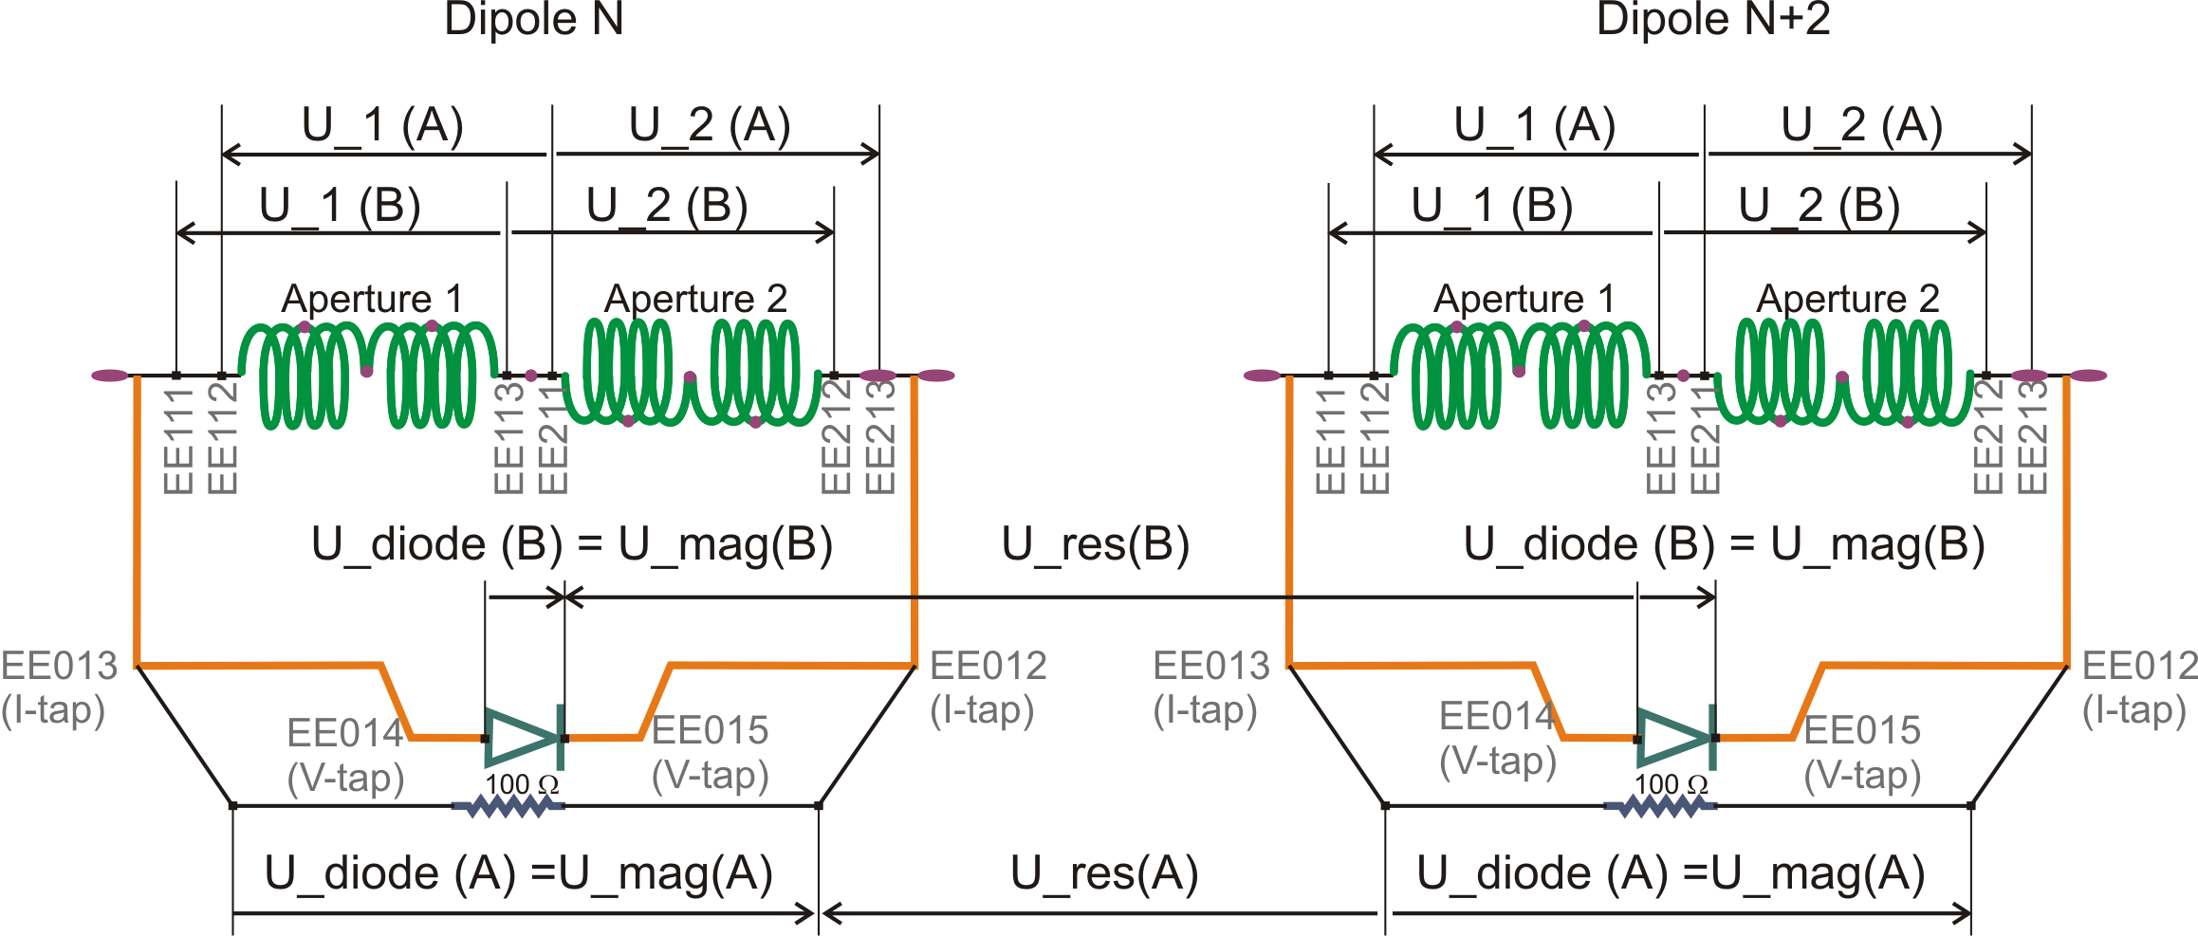
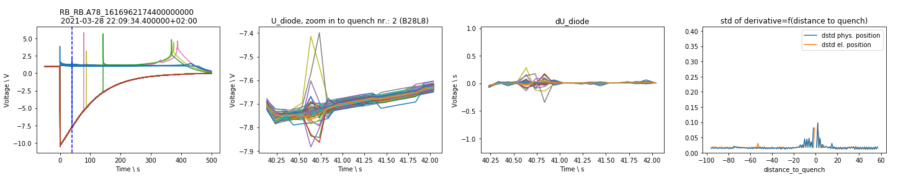
1. U Diode Secondary Quench

Slide 9
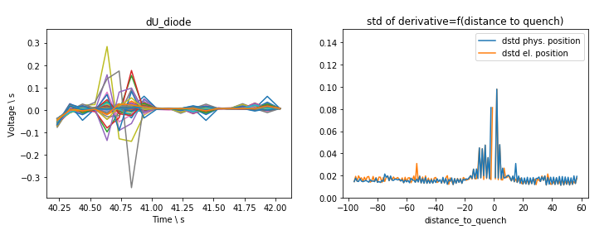
Manual Feature Engineering
Classification of oscillations after secondary quenches
-2
0
150
-1
1
151

Slide 10
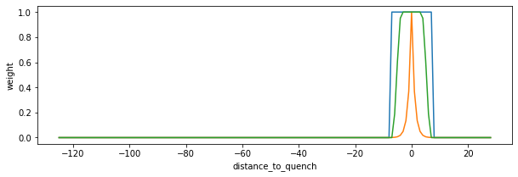
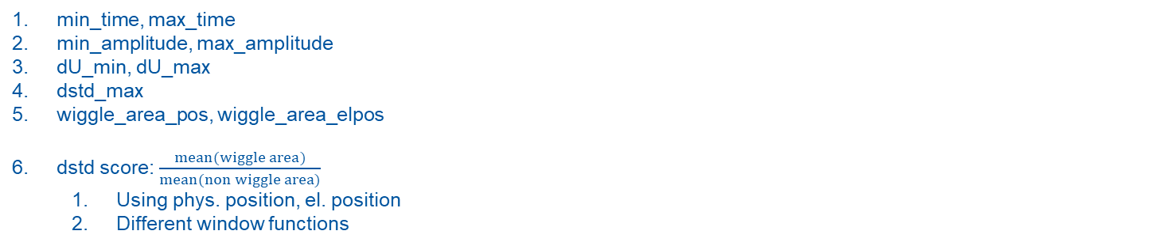
Manual Feature Engineering
2
3
4
2
3
1
min_time, max_time
min_amplitude, max_amplitude
dU_min, dU_max
dstd_max
wiggle_area_pos, wiggle_area_elpos
dstd score: $\frac{mean(wiggle area)}{mean(non wiggle area)}$
Using phys. position, el. position
Different window functions
5
5

Slide 11
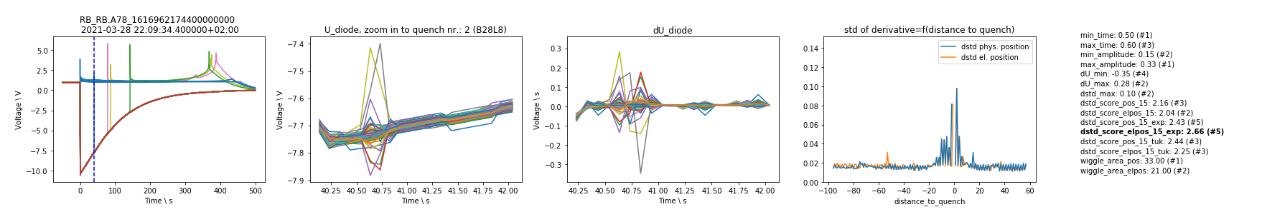
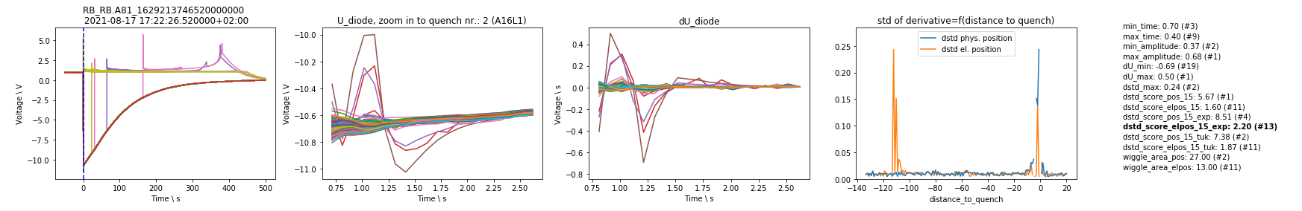
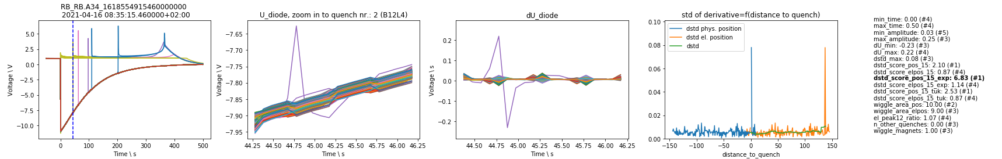
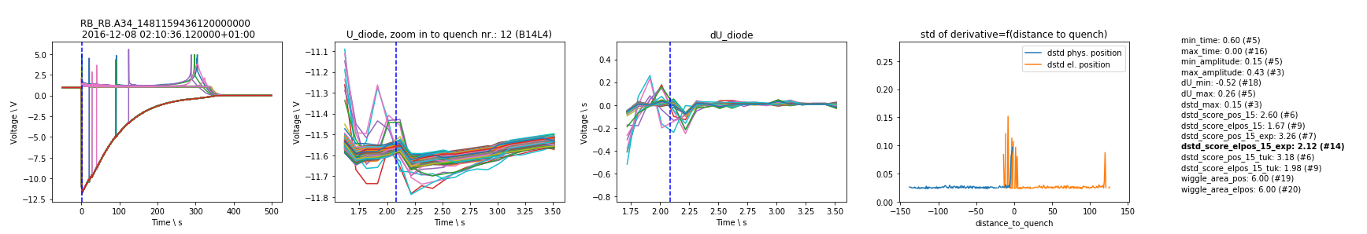
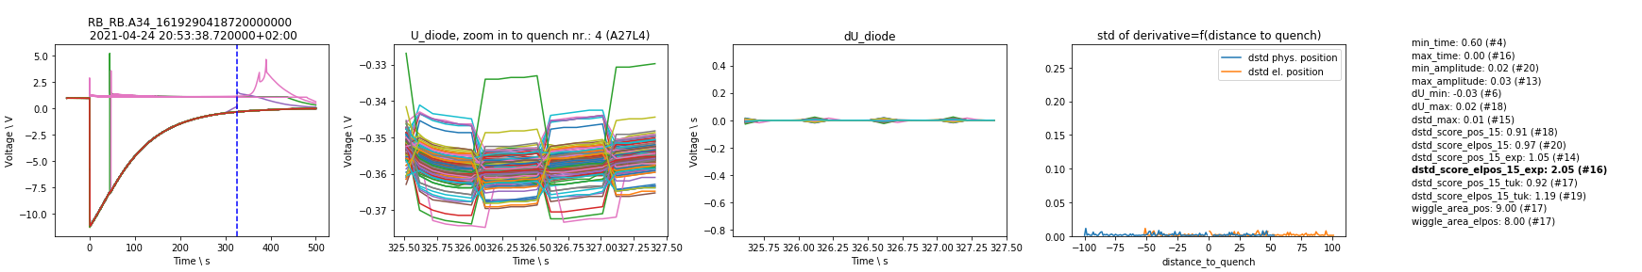
1. Oscillation that only propagates electrically
Reason: electric coupling?
2. Oscillation that propagates physically and electrically
Reason: electric coupling through grounding?
Special case: Oscillation in only one magnet
3. Oscillation due to another quench in time window
Reason: coupling of magnets
4. Oscillation due to acquisition
Reason: acquisition
Manual Threshold

Slide 12
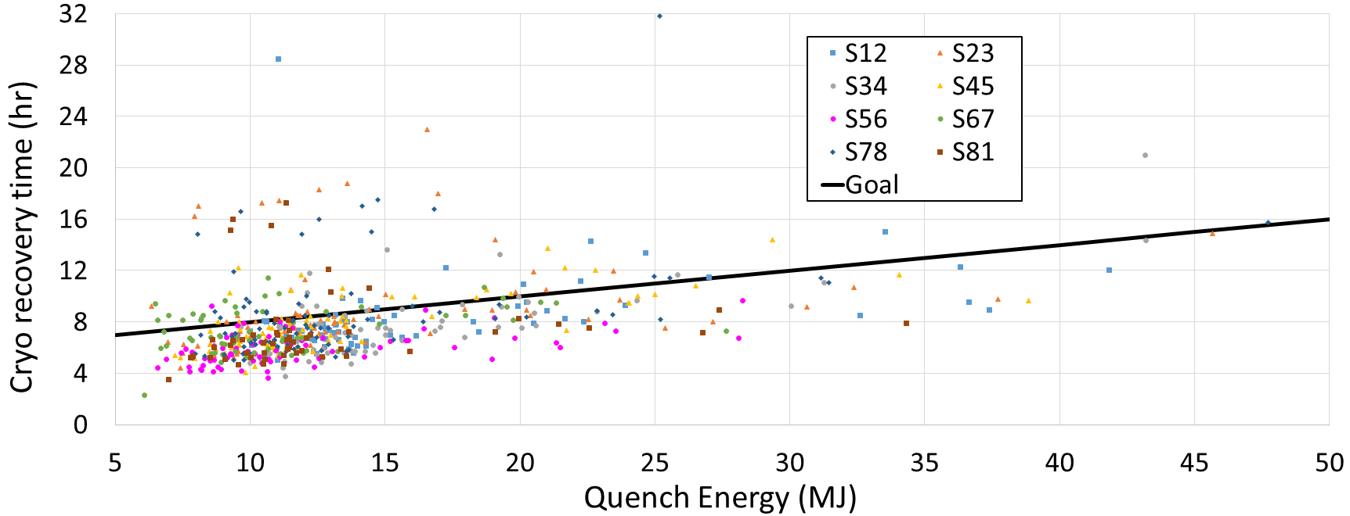
Find Probabilities
Wiggle: How does the dstd score evolve in B28L8, compared to other magnets
Probabilistic

Slide 13
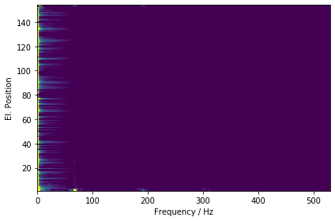
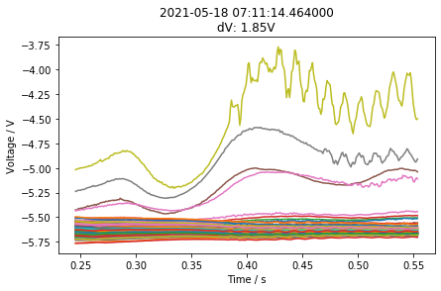
2. U Diode Primary Quench
U Diode PM
1st Energy Extraction
Frequency Domain

Slide 14
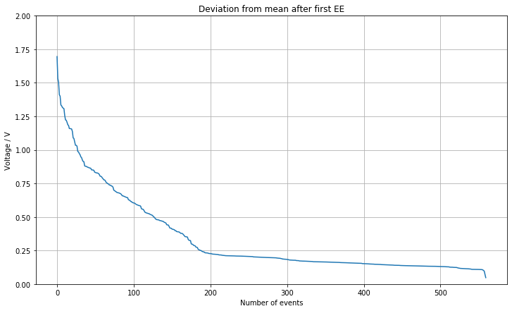
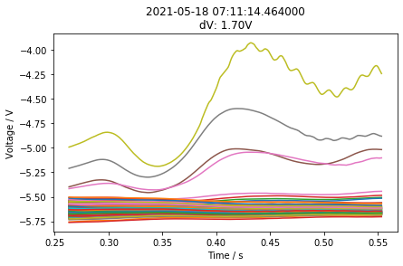
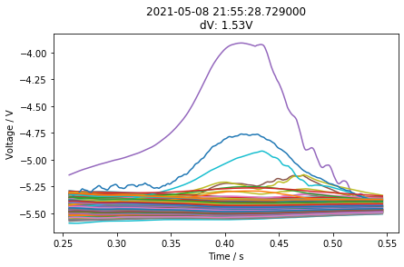
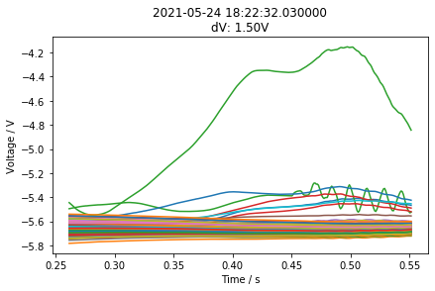
Sunglass Threshold
Effect threshold to #quenches.
Filter: 20ms moving average

Slide 15
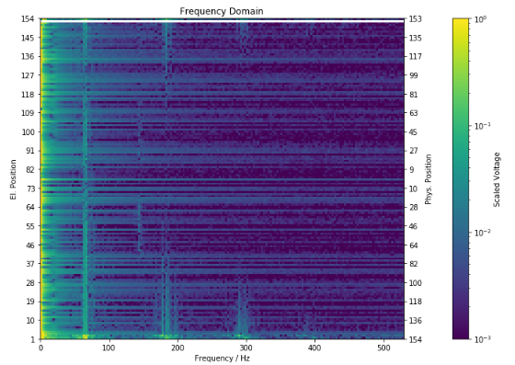
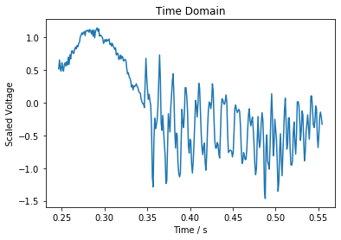
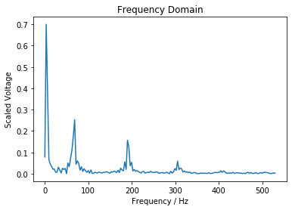
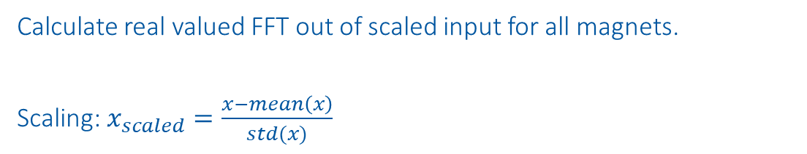
Frequency Domain
Calculate real valued FFT out of scaled input for all magnets.
Scaling: $x_{scaled}=\frac{x−mean\left(x\right)}{std(x)}$

Slide 16
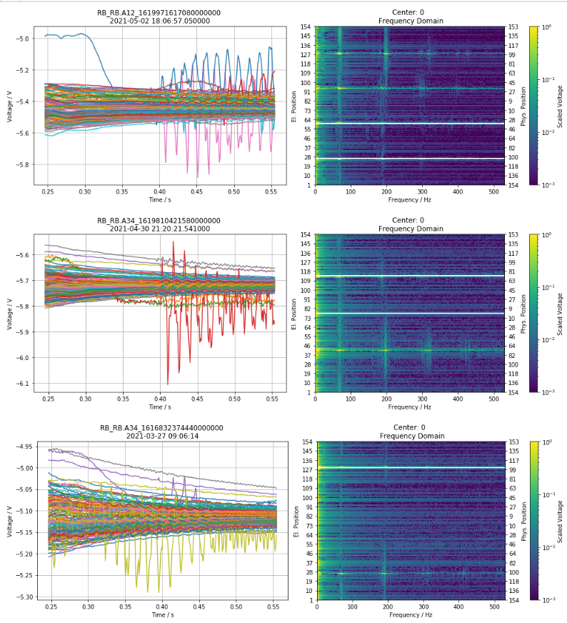
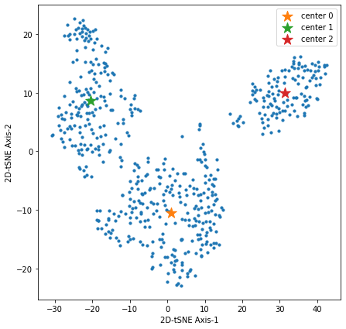
2D-tSNE Frequency Domain
tSNE input: all maximal frequencies per magnet (events, frequency)

Slide 17
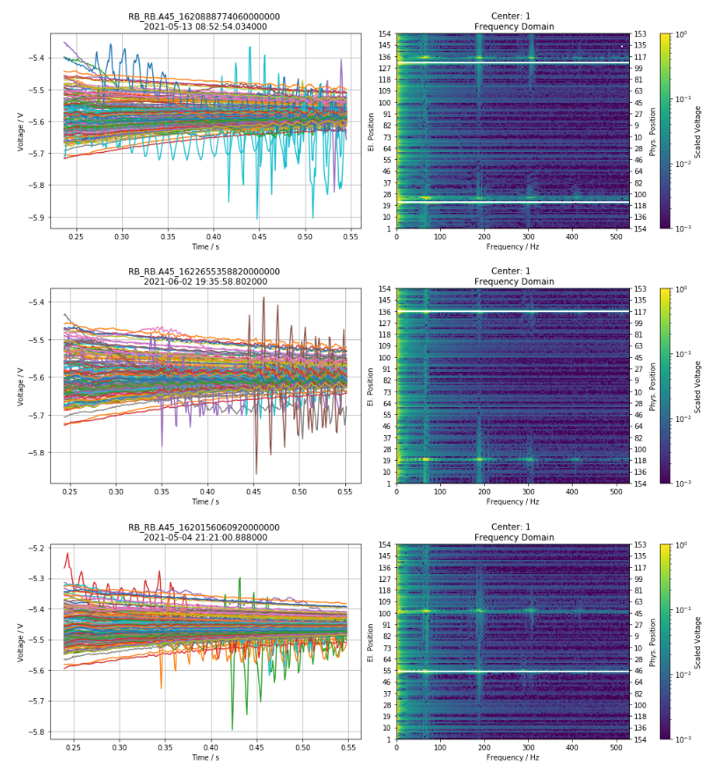
2D-tSNE Frequency Domain
tSNE input: all maximal frequencies per magnet (events, frequency)

Slide 18
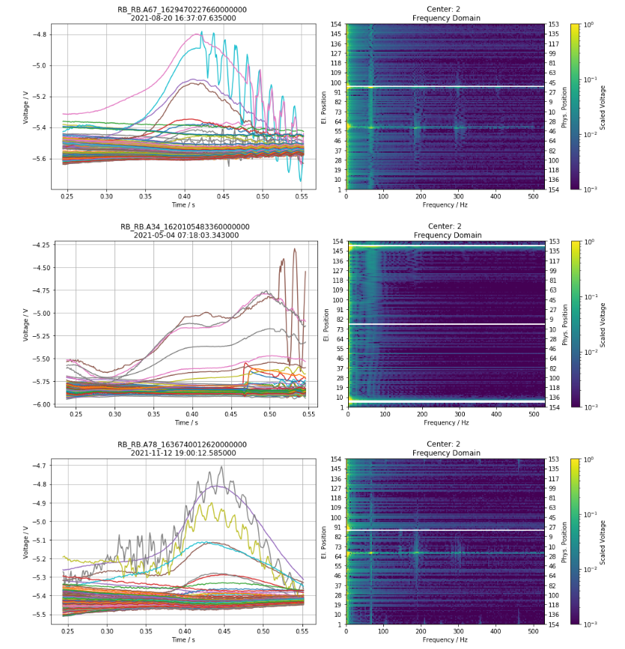
2D-tSNE Frequency Domain
tSNE input: all maximal frequencies per magnet (events, frequency)

Slide 19
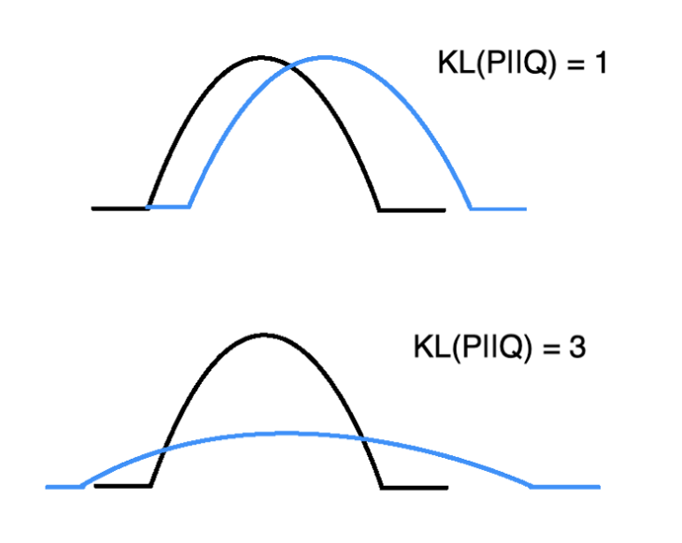
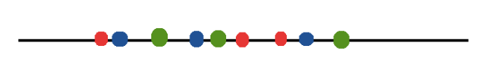
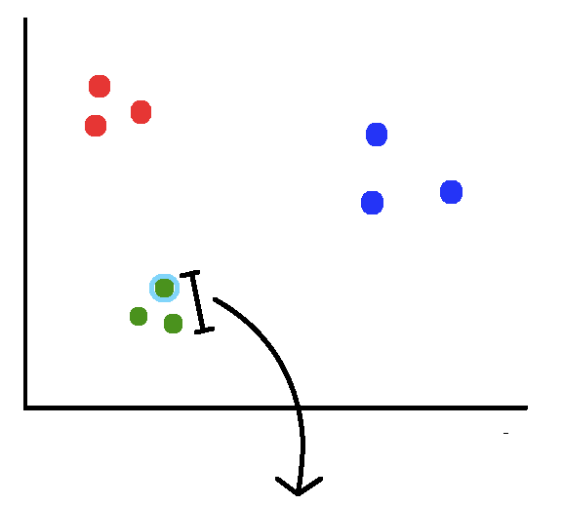
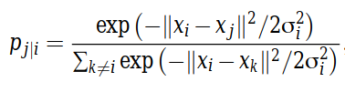
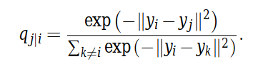
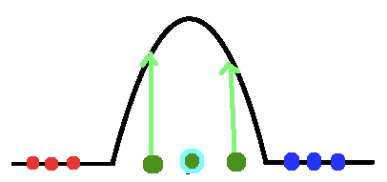
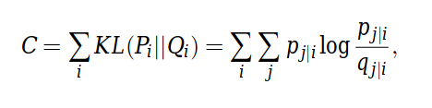
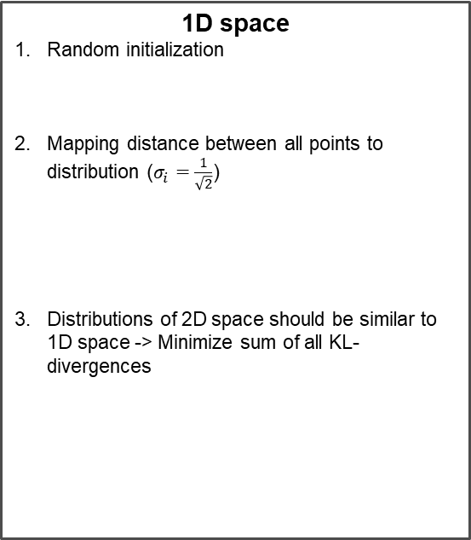

Finding concepts – tSNE overview
Example: Project 2D space to 1D space
2D space
1. Mapping distance between all points to distribution
1D space
Random initialization
Mapping distance between all points to distribution ($σ_{i}=\frac{1}{\sqrt{2}}$)
Distributions of 2D space should be similar to 1D space -> Minimize sum of all KL-divergences
KL-divergence
$$min⁡C$$
Classic Machine Learning

Slide 20
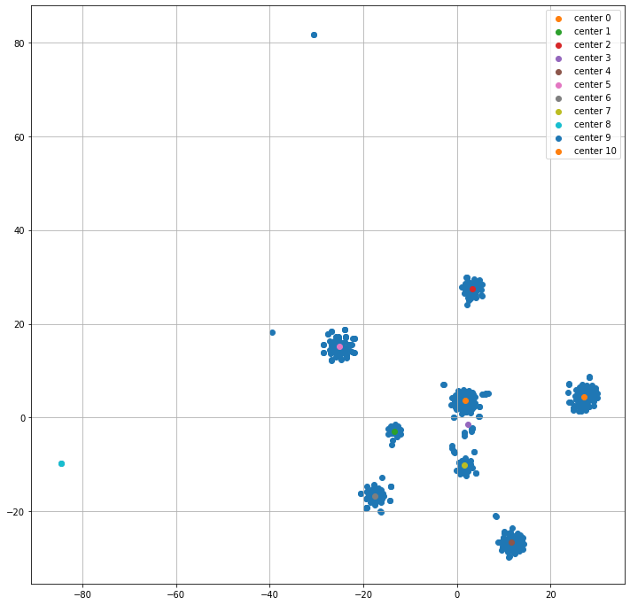
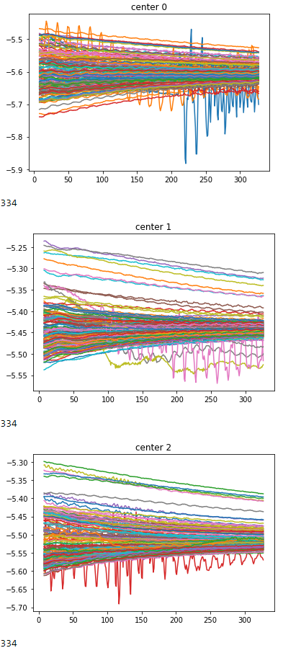
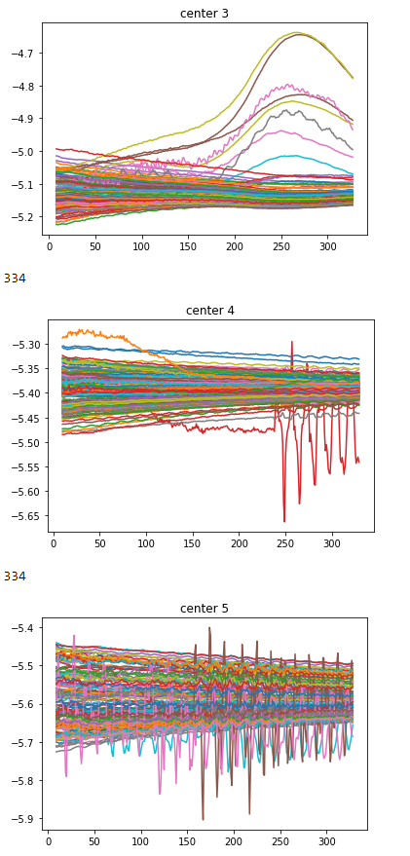
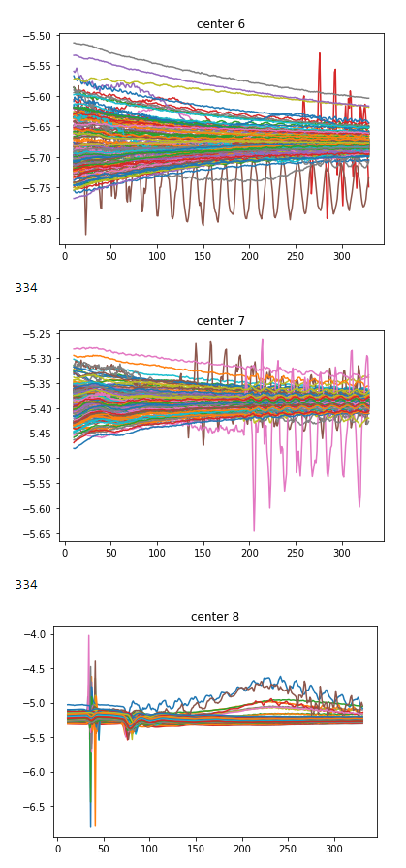
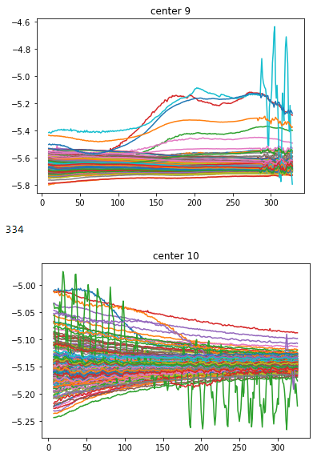
Finding concepts
Find different concepts of different anomalies in data
Example: Concepts in EE plateaus of U_diode PM
2D-tSNE axis 2
2D-tSNE axis 1
Classic Machine Learning

Slide 21
2. U Diode Full Quench

Slide 22
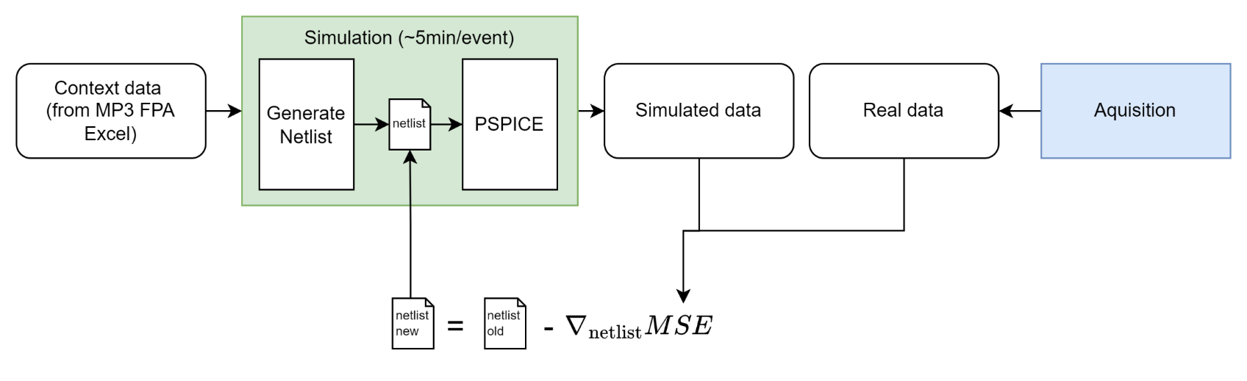
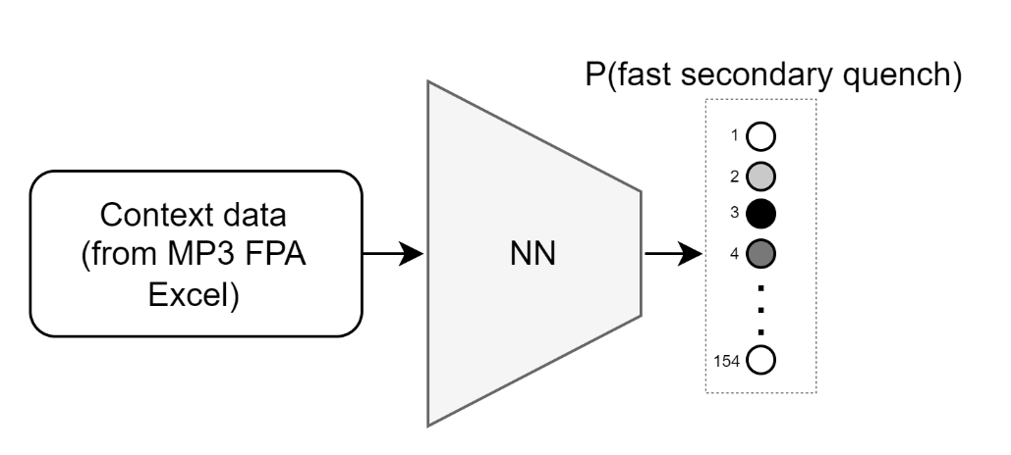
Predict parameters
a.) Neural netlist optimization: Improve simulations with gradient descent
b.) Predict fast secondary quenches with CLIC approach: Use Explainable AI to see what the NN was looking at
Discriminative Deep Learning

Slide 23
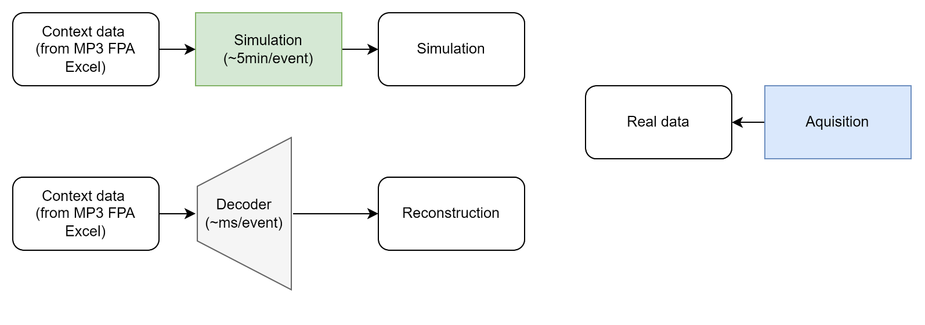

Generate data
Can ML generate data faster/more accurate than simulations? Using the same input
Optimization of decoder weights with MSE between real data and simulated data
Advantages:
Decoder can create within seconds, more similar to real data
Detection of anomalies with MSE
Disadvantage: Black box
Generative Deep Learning

Slide 24


Generate data
Can ML generate data faster/more accurate than simulations?
Generative Deep Learning

Slide 25
Discussion
Feature analysis:
Analyze both EE sunglasses, dependent on threshold, also within event
Find probabilities:
How does the dstd score evolve in B28L8, do other magnets evolve similarly?
Find concepts:
tSNE per magnet, look at frequency domain
Predict parameters:
Optimization of magnet parameter, research PSPICE optimization techniques
Generate data:
Simulation data will be improved
Check data integrity: sum of all u diode signals + ee signals should be 0
Also use: UQS0, Voltage feelers, Quench heaters
Genetische Optimierung,

